Slide 1
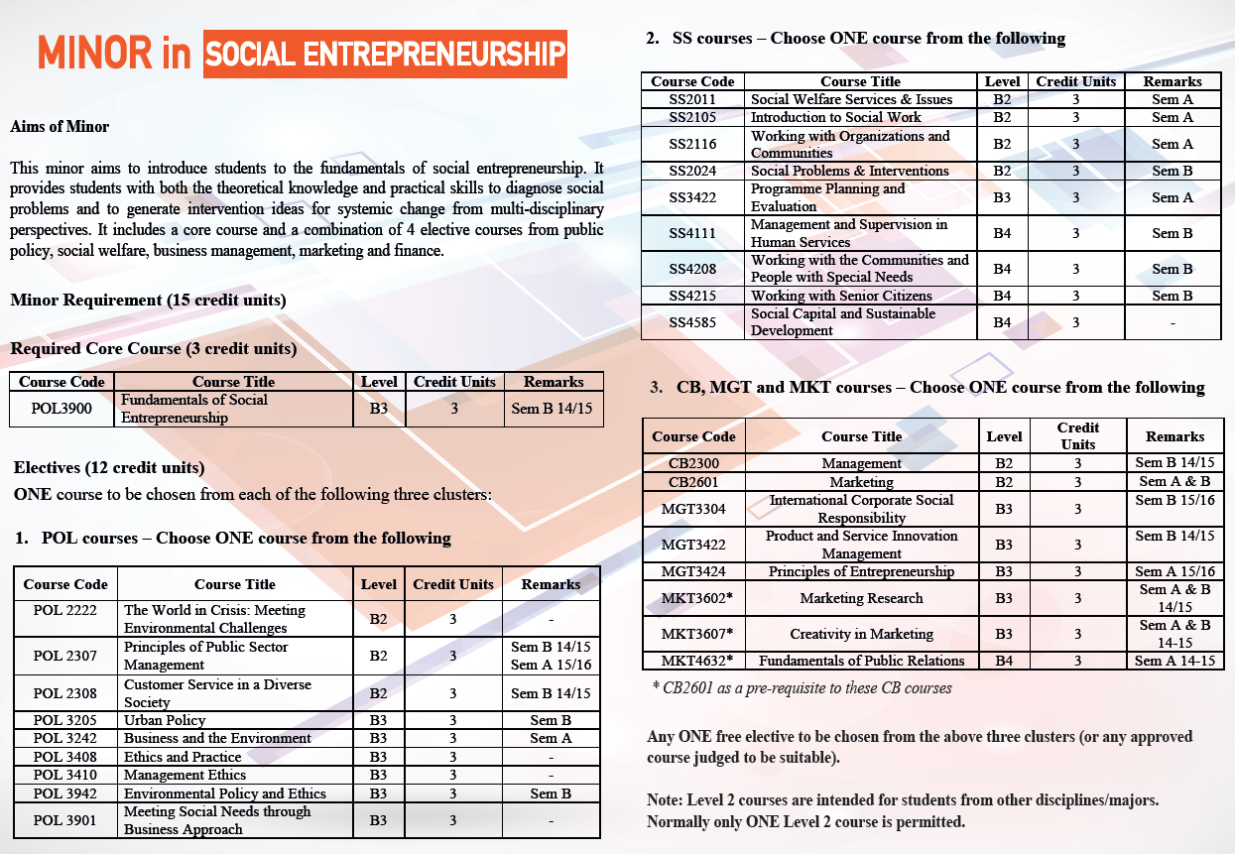

Slide 2
POL 3900 FUNDAMENTALS OF SOCIAL ENTREPRENEURSHIP

Slide 3
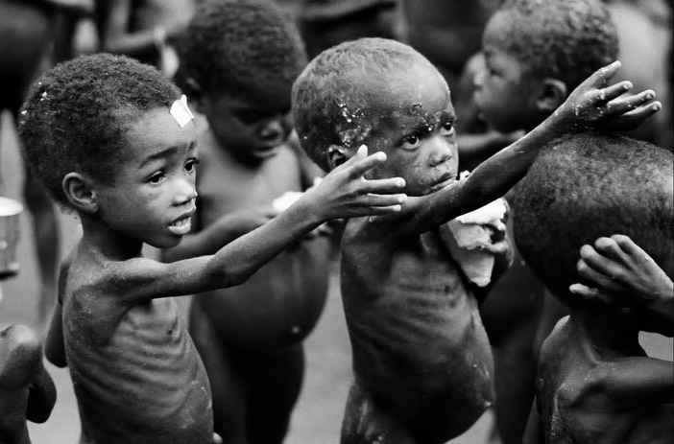
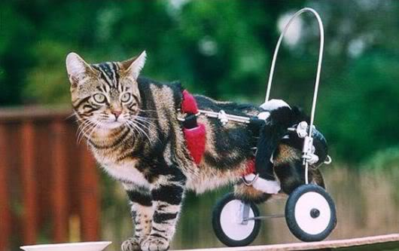

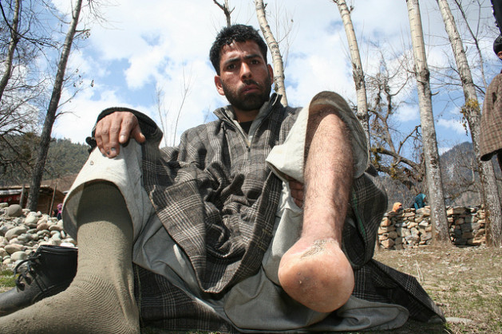
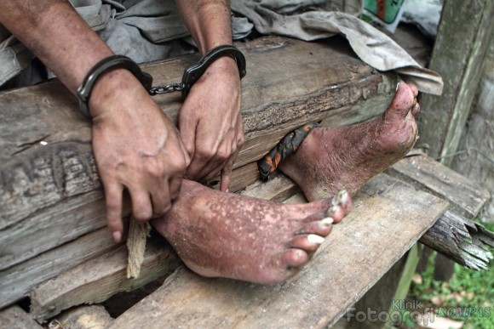
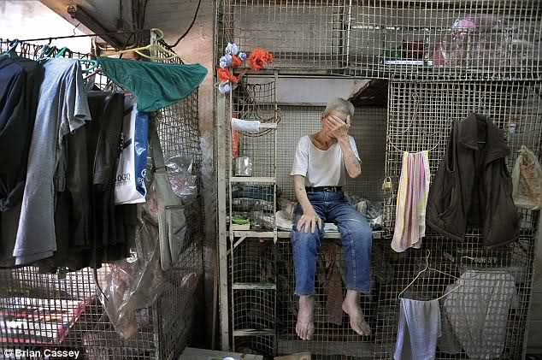
SOCIAL PROBLEMS around us
Poverty
Animal rights
Pollution
Landmines
Human rights
Housing problems
Aging society…
Child trafficking
Child abuse
Social exclusion
Drug trafficking
Climate change
https://www.youtube.com/watch?v=1QgToSjQ7os

Slide 4
Social welfare
logic
Hybrid
logic
Commercial
logic
Non Profit
Organizations
Social
Enterprises
For-Profit
Organizations
Combining social mission and strong business model to create positive impact
at the societal/systems level

Slide 5

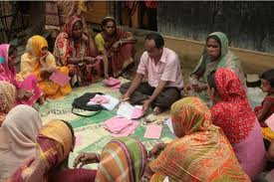
Microfinance: collateral free small loans

Slide 6



Empowering the disabled & ex-offenders

Slide 7
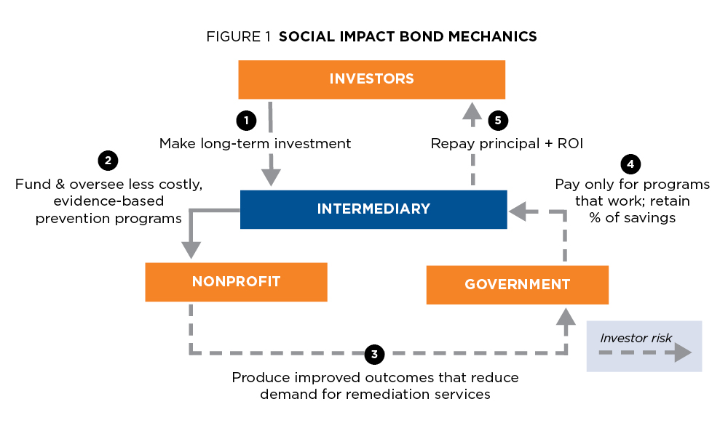
Social impact bond: pay for success

Slide 8
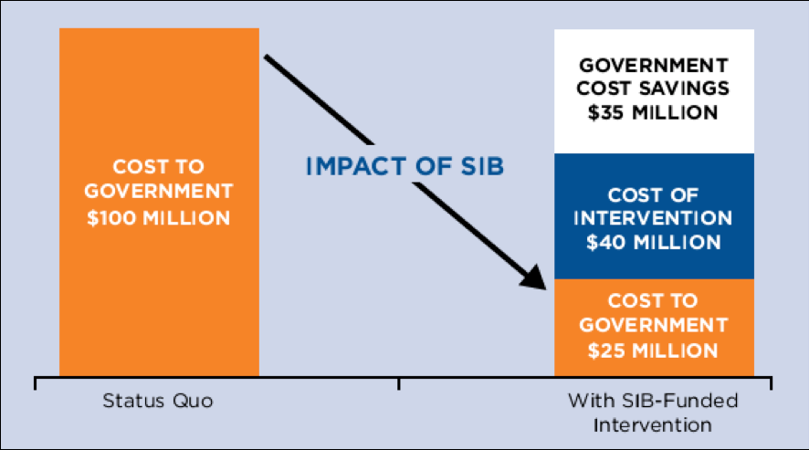
Social impact bond is a win-win solution
http://www.forbes.com/sites/jonhartley/2014/09/15/social-impact-bonds-are-going-mainstream/

Slide 9
The world needs a new WAY OF THINKING, a new APPROACH to solving pressing social problems: SOCIAL ENTREPRENEURSHIP
Business doesn’t always have to be money-centered, self-centered or obsessed with money
Using business tools to solve societal problems
Innovations, Sustainability & Impact are central elements

Slide 10
Course Content
The limit of the Big Government, Big NGOs, Big Corporates
Different types of social enterprises
Social innovation: tools and techniques
Strategic planning & marketing in social enterprise
Budgeting, Financing and Fundraising
Leadership in social enterprise
Media & Communication for social good
Measuring Impact and stakeholder accountability
Practitioner Sharing

Slide 11
Assessments
Components | Weighting
A Journey of My Life | 20%
Case study write up | 10%
Project Presentation (social business plan) | 30%
Final Exam | 40%
TOTAL | 100%

